Slide 1
36th ICTCT conference, 17–18 October 2024, the Hague, the Netherlands

Slide 7
Colour scheme
Dark background
RGB: (41, 63, 125)
HEX: #293f7d
Header
RGB: (145, 176, 201)
HEX: #91b0c9
Light background
RGB: (234, 243, 250)
HEX: #eaf3fa
Accent colour
RGB: (255, 0, 0)
HEX: #FF0000

Slide 8
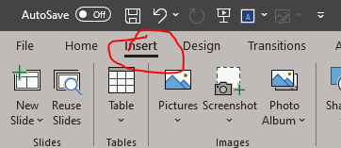
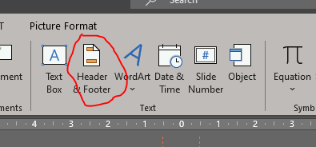
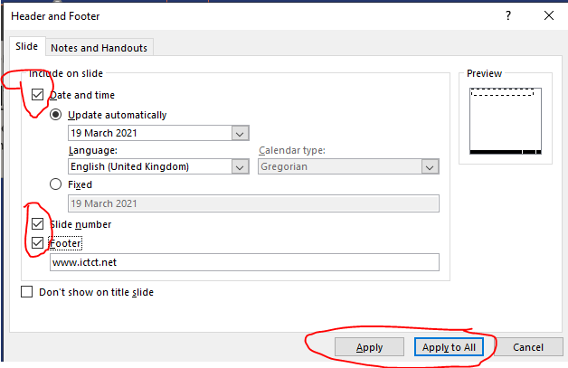
How to add date & slide numbers (NOT recommended, though)
1.
2.
3.

